Slide 1
Ch 5. The Link Layer and Local Area Networks
(Computer Networking by Kurose)
Myungchul Kim
mck@kaist.ac.kr

Slide 2
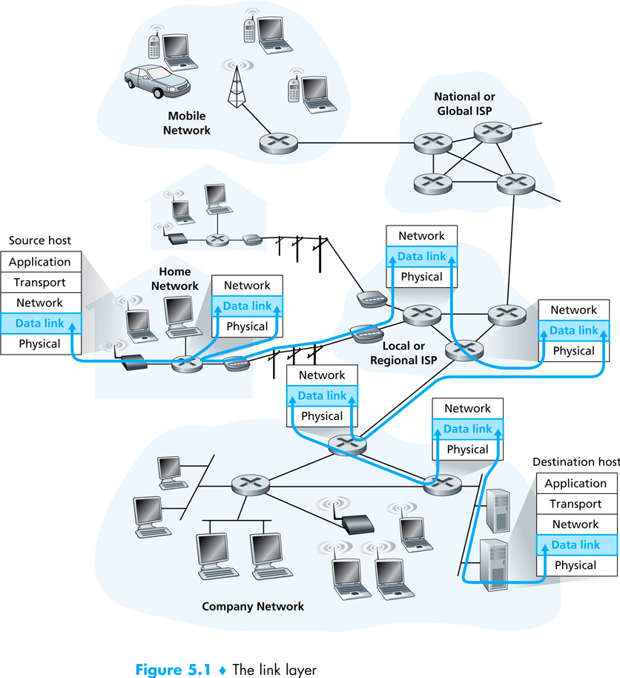

Slide 3
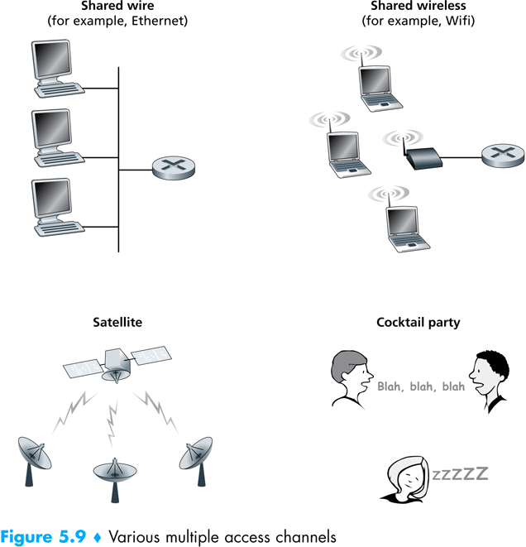
Multiple access protocols
  Point-to-point link
  Broadcast link: medium access problem
  Multiple access protocols
  Channel partitioning protocols, random access protocols and taking-turns protocols

Slide 4
Ideal Multiple Access Protocol
Broadcast channel of rate R bps
1. when one node wants to transmit, it can send at rate R.
2. when M nodes want to transmit, each can send at average rate R/M
3. fully decentralized:
  no special node to coordinate transmissions
  no synchronization of clocks, slots
4. simple

Slide 5
  Carrier Sense Multiple Access (CSMA)
    Listen before speaking: carrier sensing
    If someone else begins talking at the same time, stop talking: collision detection
    CSMA, CSMA/CD

Slide 6
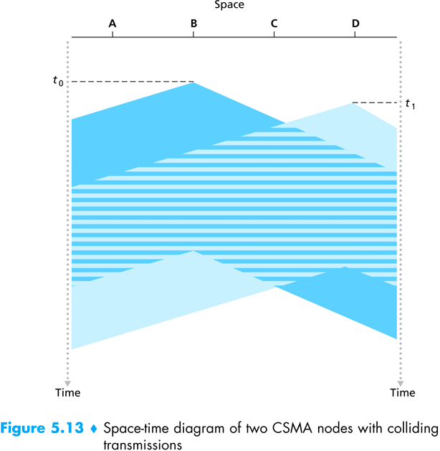

Slide 7
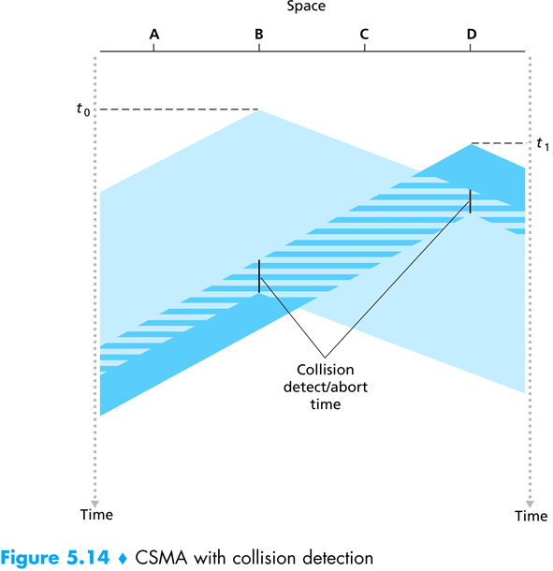

Slide 8
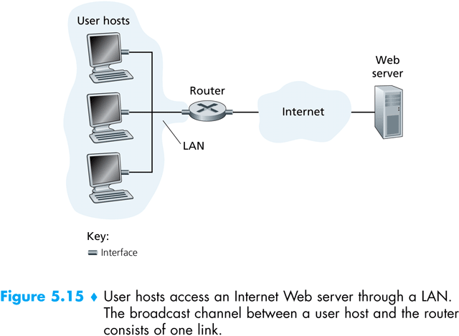
Taking-Turns protocols
  Polling protocols: a master node
  Token-passing protocol: no master node
  Adv.
Local Area Networks (LANs)
  Ethernet: IEEE 802.3
  Token Ring: IEEE 802.5
  Fiber Distribution Data Interface (FDDI)

Slide 9
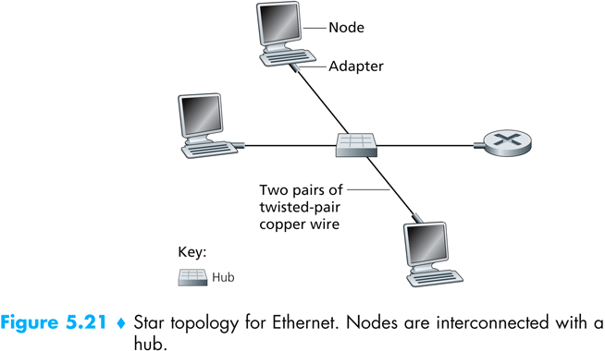
Ethernet
  Success factors
    First widely deployed
    Simple and cheap
    Kept up with speed race
  Hub: whenever a hub receives a bit from one of its interfaces, it sends a copy of the bit to all of its other interfaces.

Slide 10
CSMA/CD: Ethernet’s Multiple Access Protocol
  An adapter may begin to transmit at any time.
  An adapter never transmits a frame when it senses that some other adapter is transmitting. (carrier sensing)
  A transmitting adapter aborts its transmission as soon as it detects that another adapter is also transmitting. (collision detection)
  Before attempting a retransmission, and adapter waits a random time that is typically small compared with the time to transmit a frame. (exponential backoff)

Slide 11
Ethernet’s CSMA/CD (more)
Jam Signal: make sure all other transmitters are aware of collision; 48 bits
Bit time: 0.1 microsec for 10 Mbps Ethernet ; K * 512 bit times for waiting
for K=1023, wait time is about 50 msec
Exponential Backoff:
Goal: adapt retransmission attempts to estimated current load
  heavy load: random wait will be longer
first collision: choose K from {0,1}; delay is K· 512 bit transmission times
after second collision: choose K from {0,1,2,3}…
after ten collisions, choose K from {0,1,2,3,4,…,1023}
5: DataLink Layer
5-<number>

Slide 12
Ch 6. Wireless and Mobile Networks
(Computer Networking by Kurose)
Myungchul Kim
mckim@cs.kaist.ac.kr

Slide 13
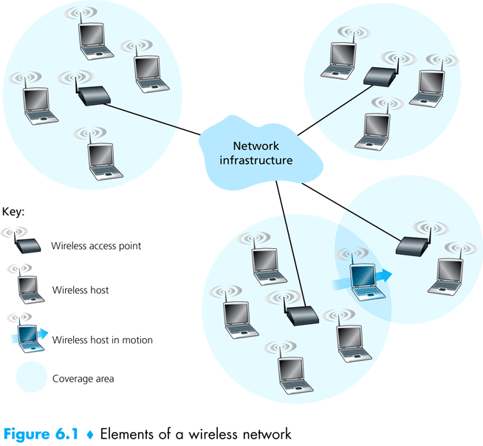
  Wirless hosts
  Wireless links
  Base station: (e.g., cell towers, access points) handoff
    Infrastructure mode
    Ad hoc mode

Slide 14
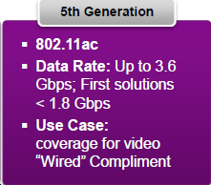
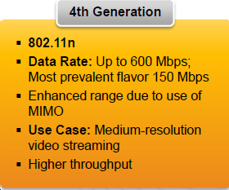
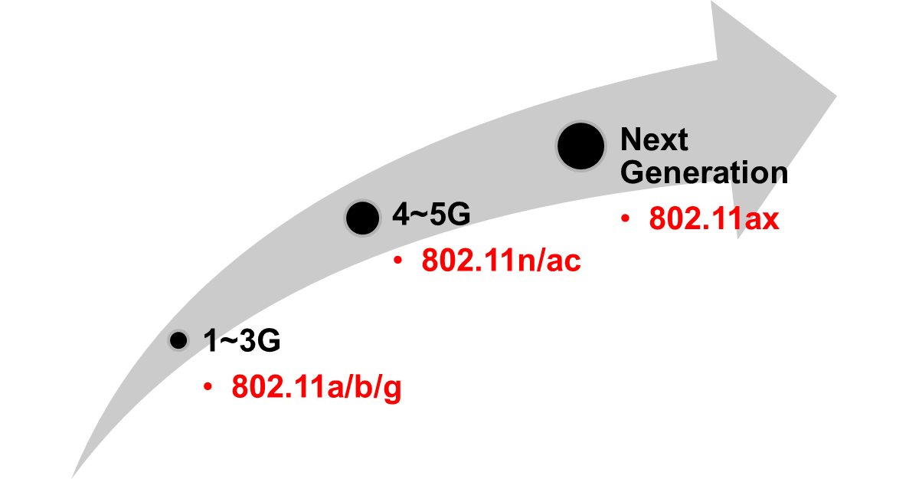
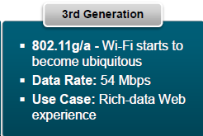
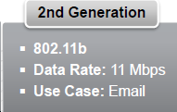
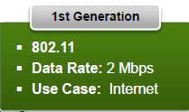
Evolving Wi-Fi
Local Area Network
(2.4 & 5GHz)
<2012>
<2007>
<2002>
<1999>
Wide Area Network
(Sub 1GHz)
Super Wi-Fi
802.11ah/af
<1997>
Reference: [5-10]
Slide <number>
Notes:
doc.: IEEE 802.11-yy/xxxxr0
Il-Gu Lee, ETRI
Page <number>

Slide 15
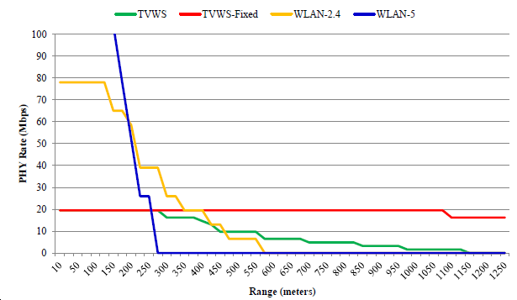
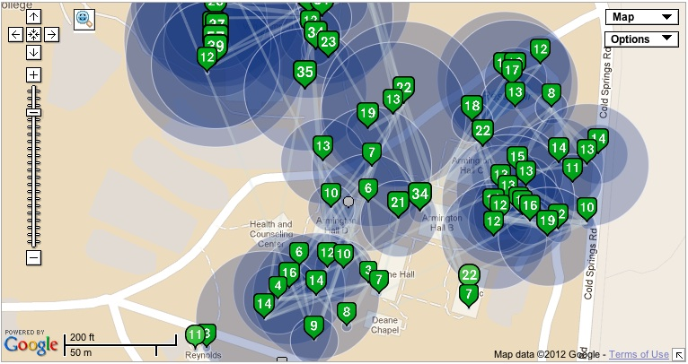
Evolving Wi-Fi
Denser
Network
Wider Bandwidth
Local Area Network
(2.4 & 5GHz)
<2012>
<2007>
<2002>
Longer
Coverage
<1999>
Wide Area Network
(Sub 1GHz)
Super Wi-Fi
802.11ah/af
<1997>
Reference: [5-10]
Slide <number>
Notes:
doc.: IEEE 802.11-yy/xxxxr0
Il-Gu Lee, ETRI
Page <number>

Slide 16
Wireless network taxonomy
single hop
multiple hops
host connects to
base station (WiFi,
WiMAX, cellular)
which connects to
larger Internet
host may have to
relay through several
wireless nodes to
connect to larger
Internet: mesh net
infrastructure
(e.g., APs)
no base station, no
connection to larger
Internet. May have to
relay to reach other
a given wireless node
MANET, VANET
no
infrastructure
no base station, no
connection to larger
Internet (Bluetooth,
ad hoc nets)

Slide 17
Wireless links and network characteristics
Differences between a wired link and a wireless link
  Decreasing signal strength
  Interference from other source
  Multipath propagation
Signal-to-noise ratio (SNR)
  A relative measure of the strength of the received signal and the noise.
  dB
Bit error rate (BER)

Slide 18
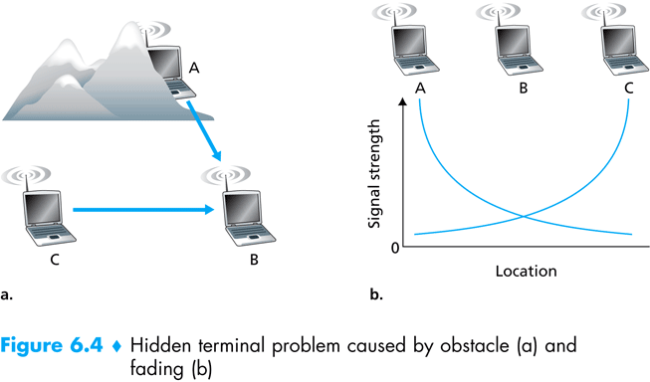

Slide 19
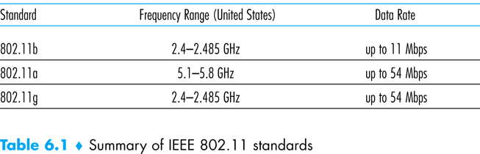
WiFi: 802.11 Wireless LANs
  802.11n: multiple-input multiple-output (MIMO) antennas, over 100Mbps, compatible with 802.11a/b/g devices

Slide 20
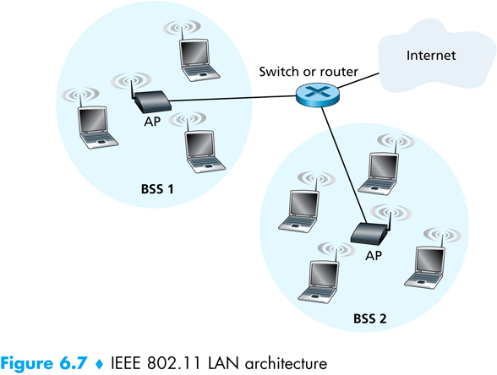
The 802.11 architecture
  Basic service set (BSS): service set identifer (SSID)

Slide 21
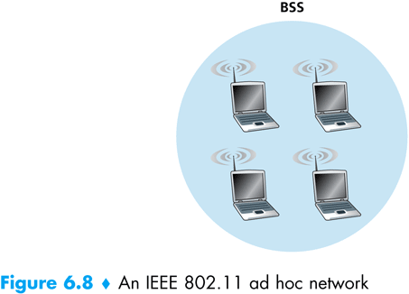

Slide 22
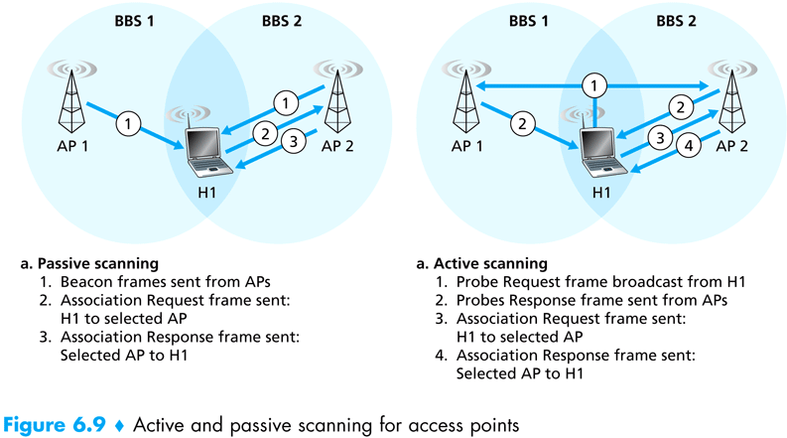
Channels and association
  11 partially overlapping channels
  Max Transfer Rate= 33 Mbps: separated by four channels (e.g., 1, 6, and 11)
  AP sends beacon frames (with AP’s SSID and MAC address)

Slide 23
  Association with authentication
    A station’s MAC address
    Usernames and passwds by RADIUS or DIAMETER
The 802.11 MAC protocol
  CSMA/Collision Avoidance
  Differences from Ethernet
    Collision avoidance
    Link-layer acknowledgement/retransmission
  No collision detection
    Costly to build hardware that can detect a collision
    No detection of all collisions due to the hidden terminal problem and fading

Slide 24
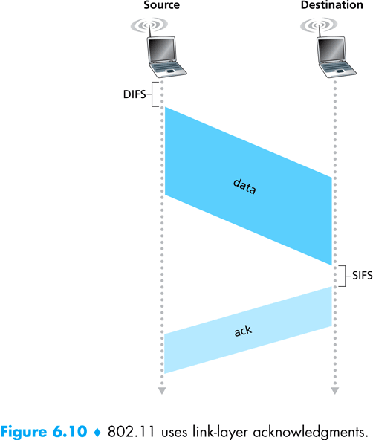

Slide 25
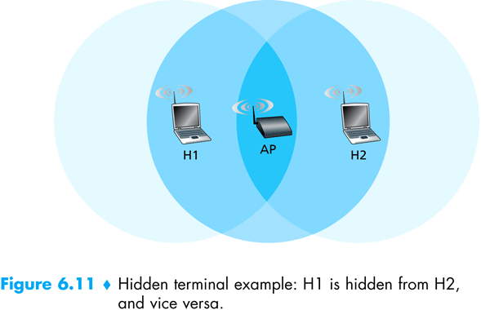
Dealing with hidden terminals: RTS and CTS
  RTS (including the total time required to transmit the DATA and the ACK) and CTS to reserve access to the channel
  CTS: gives the sender explicit permission to send and also instructs the other stations not to send for the reserved duration.
  RTS/CTS is used only when the frame is longer than the threshold.

Slide 26


IEEE 802.11: multiple access
avoid collisions: 2⁺ nodes transmitting at same time
802.11: CSMA - sense before transmitting
  don’t collide with ongoing transmission by other node
802.11: no collision detection!
  difficult to receive (sense collisions) when transmitting due to weak received signals (fading)
  can’t sense all collisions in any case: hidden terminal, fading
  goal: avoid collisions: CSMA/C(ollision)A(voidance)
A
B
C
C
A’s signal
strength
C’s signal
strength
B
A
space
6: Wireless and Mobile Networks
6-<number>

Slide 27
Avoiding collisions
idea: allow sender to “reserve” channel rather than random access of data frames: avoid collisions of long data frames
sender first transmits small request-to-send (RTS) packets to BS using CSMA
  RTSs may still collide with each other (but they’re short)
BS broadcasts clear-to-send CTS in response to RTS
RTS heard by all nodes
  sender transmits data frame
  other stations defer transmissions
avoid data frame collisions completely
using small reservation packets!??
6: Wireless and Mobile Networks
6-<number>

Slide 28
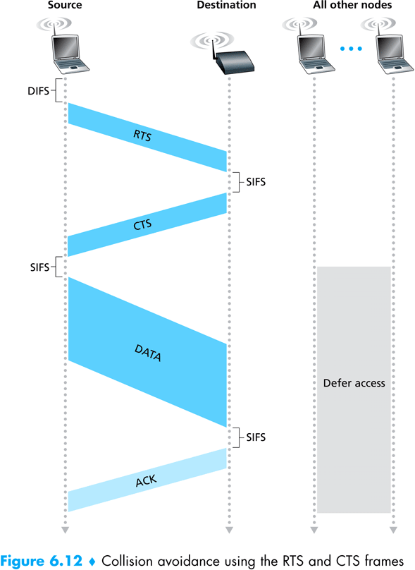

Slide 29
Collision Avoidance: RTS-CTS exchange
A
B
AP
RTS(B)
RTS(A)
reservation collision
RTS(A)
CTS(A)
CTS(A)
DATA (A)
defer
time
ACK(A)
ACK(A)

Slide 30
Advanced features in 802.11
  802.11 rate adaptation: select the underlying physical-layer modulation technique to use based on current channel characteristics -> similar to TCP congestion control
  Power management: alternate between sleep and wake states, 250 microseconds for wakeup.
Bluetooth
  IEEE 802.15.1
  Wireless personal area network
  4Mbps
  Ad hoc networks
  A piconet of up to eight active devices

Slide 31
WiMAX
  IEEE 802.16
  Wireless ADSL
  TDM
  Speeds of 70-80 miles per hour

Slide 32
Wireless and mobility: impact on higher layer protocols
Packet loss in TCP
  Network congestion
  Handoff
  Wireless communication
Approaches
  Local recovery
  TCP sender awareness of wireless links
  Split-connection approaches: two tranport-layer connections

